Slide 1
REACT-REDUX TESTING WORKSHOP
Marianna Etelson
April 2018 @ JSHeroes

Slide 2
AGENDA
Intro
Why ?
What ?
Testing Guidelines

Slide 3
AGENDA
How
Test Environment
Hands-On
React Component
Redux: Action, Reducer, Container
Integration Test

Slide 4

WHY?
because my boss said so…
Maintainable code
Definition of what the code should do
Usage examples built into our library
CI/CD
I NEED ONE MORE TEST!

Slide 5
TEST TYPES
E2E
evaluate the end-to-end
system’s compliance with its specified requirements
Integration Test
T E S T I N G
individual software modules are
combined and tested as a group
Unit Test
smallest piece of testable software in the application

Slide 6

WHAT?
what are we testing…
Find out what exactly we would like to test
Do NOT test 3rd and 1st party dependencies
If testing the integration with external code, test ONLY the integration

Slide 7
TESTS GUIDELINES
Should ALWAYS produce the same results
Should NOT be concurrent unless we want to test concurrency
Should NOT repeat themselves

Slide 8
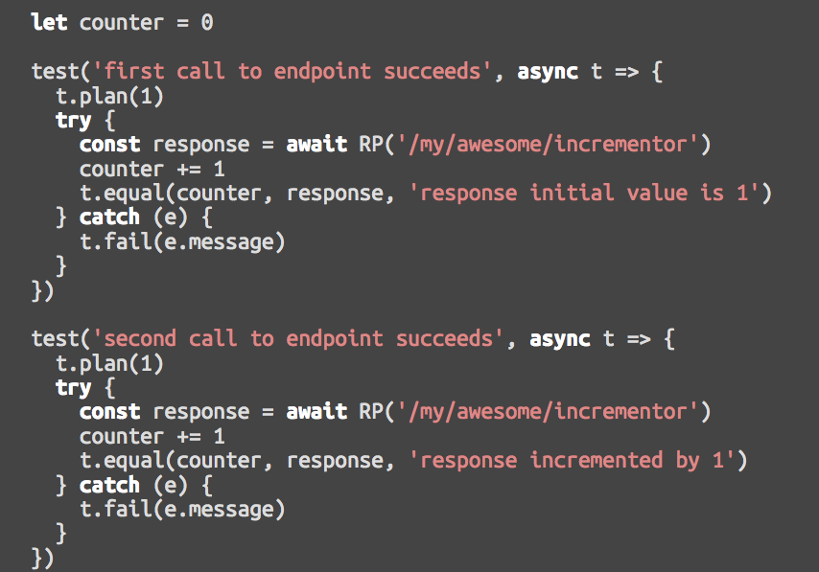
TESTS GUIDELINES – continue…
Should NOT rely on other tests or test order
BAD...

Slide 9
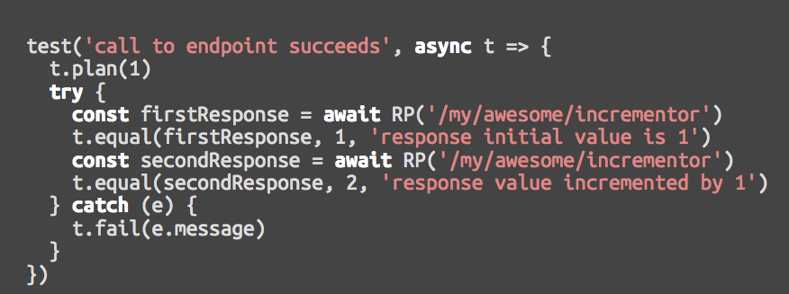
TESTS GUIDELINES – continue…
Should NOT rely on other tests or test order
BETTER…

Slide 10
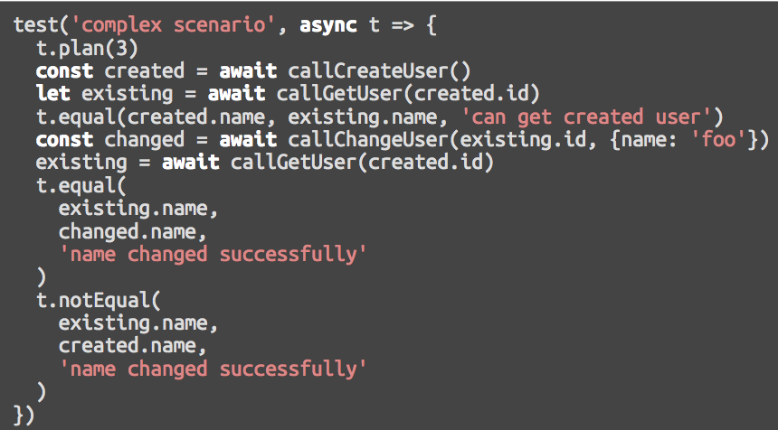
TESTS GUIDELINES – continue…
Should be simple, short and self explanatory
BAD...

Slide 11
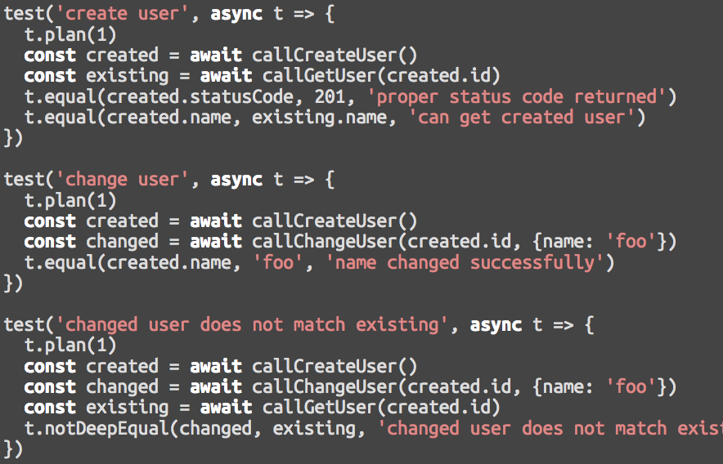
TESTS GUIDELINES – continue…
Should be simple, short and self explanatory
BETTER…

Slide 12
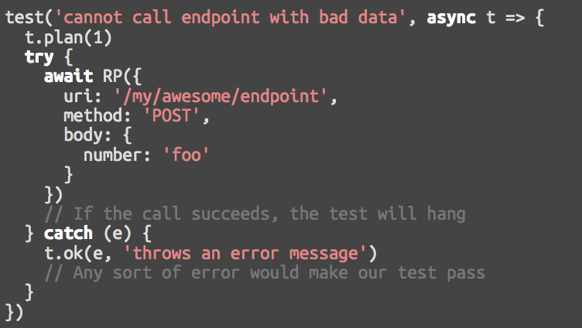
TESTS GUIDELINES – continue…
Provide proper error messages
BAD...

Slide 13
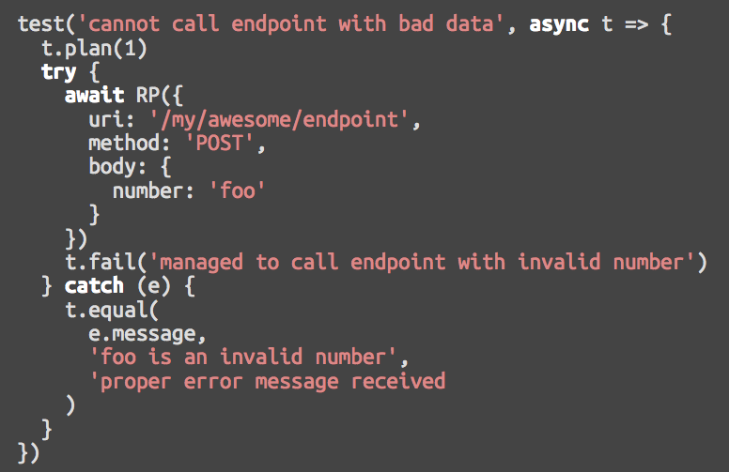
TESTS GUIDELINES – continue…
Provide proper error messages
BETTER…

Slide 14
AGENDA
Intro
Why ?
What ?
Testing Guidelines
How
Test Environment
Hands-On
React Component
Redux: Action, Reducer, Container
Integration Test

Slide 15
TEST ENVIRONMENT
Testing Framework : Tape
Tap-producing (Test Anything Protocol) test harness for node and browsers
Simple API
Built-in assertion mechanism
No global functions
Tests are executed serially
Notes:
Simple API
Very simple API that doesn't require globals, or monkey patching objects for assertions.
Built-in assert
This way you don't have to add more dependencies and external assertion libraries.
No global functions
Tape does not use global methods such as "it", "describe", since they are not considered best practice in JavaScript.
It follows the principles of TAP
TAP: Test Anything Protocol
CONS: Cannot run async test cases concurrently for faster test builds
Developer(s) James Halliday aka substack
Initial releaseNovember 25, 2012; 5 years ago
Stable release4.6.2 / 2016-09-30

Slide 16
TEST ENVIRONMENT
JSDOM
Where : in memory DOM via JSDOM
Pure JavaScript implementation of many web standards (DOM, HTML)
Fast and lightweight
Enables to run test in browser-less environment like in Node or in CI environments
Notes:
jsdom vs. PhantomJS :https://github.com/jsdom/jsdom/wiki/jsdom-vs.-PhantomJS
PhantomJS is a complete browser
PhantomJS is a complete browser (although it uses a very old and rare rendering engine). It even performs layout and rendering, allowing you to query element positions or take a screenshot. jsdom is not a full browser: it does not perform layout or rendering, and it does not support navigation between pages. It does support the DOM, HTML, canvas, many other web platform APIs, and running scripts.
So you could use jsdom to fetch the HTML of your web application (while also executing the JavaScript code within that HTML). And then you could examine and modify the resulting DOM tree. Or you could trigger event listeners to test how the web application reacts. You could also use jsdom to build up your own DOM tree from scratch, and then serialize it to a HTML string.
jsdom is more lightweight
jsdom is more lightweight
You need an executable to run PhantomJS. It is written in native code, and has to be compiled for each platform. jsdom is pure JavaScript, and runs wherever Node.js runs. It even has experimental support for running within browsers, giving you the ability to create a whole DOM Document inside a web worker.
One of the reasons jsdom is used a lot for testing is that creating a new document instance has very little overhead in jsdom. Opening a new page in PhantomJS takes a lot of time, so running a lot of small tests in fresh documents could take minutes in PhantomJS, but only seconds in jsdom.
In general, the same reasons that make jsdom pleasant for testing also make it pleasant for web scraping. In both cases, the extra power of a full browser is not as important as getting things done easily and quickly.
jsdom avoids race conditions by being in-process
Another important benefit jsdom has for testing is a bit more complicated: it is easy to suffer race conditions using an external process like PhantomJS (or Selenium). For example if you create a script to test something using PhantomJS, that script will live in a different process than the web application. If you perform multiple steps in your test that are dependent on each other (for example, step 1: find the element; step 2: click on the element), the application might change the DOM during those steps (step 1.5: the page's JavaScript removes the element).
This is not an issue in jsdom, since your tests live in exactly the same thread and event loop as the web application, so if your test is executing JavaScript code, the web application cannot run its code until your test releases control of the event loop.

Slide 17
TEST ENVIRONMENT
Testing Utility : Enzyme
JavaScript Testing utility for React
Makes easier to assert, manipulate and traverse React Components’ output
Simple API for DOM manipulation and traversing (mimicking jQuery's API )
Notes:
Airbnb

Slide 18
ENZYME SHALLOW RENDERING API shallow
Useful to constrain yourself to testing a component as a unit
Ensure that your tests aren't indirectly asserting on behavior of child components
shallow(node[, options]) => ShallowWrapper instance around the rendered output
.find(selector) =>ShallowWrapper - Find every node in the render tree that matches the provided selector
.simulate(event[, data]) =>ShallowWrapper - Simulates an event on the current node
.instance() =>ReactComponent - Returns the instance of the root component
.prop(key) =>Any - Returns the named prop of the current node
…and more

Slide 19
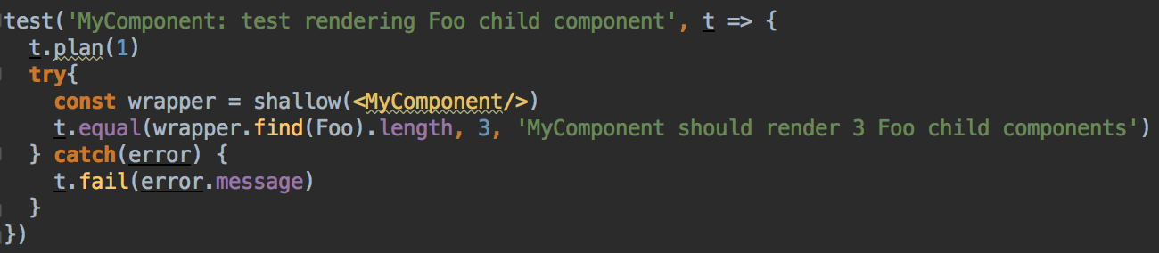
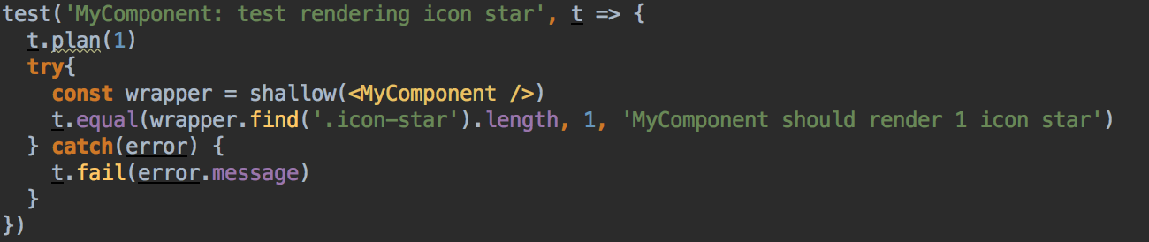
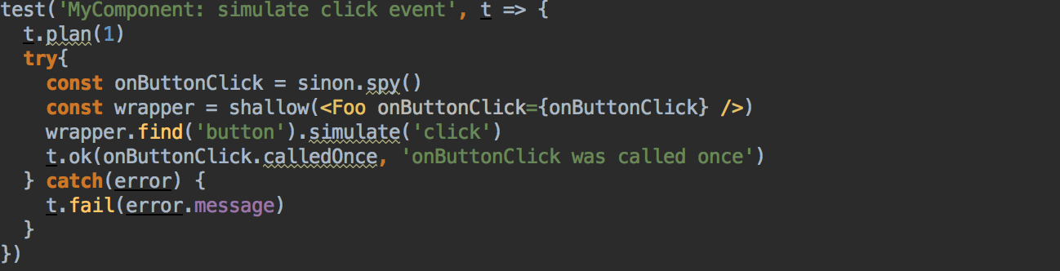
ENZYME SHALLOW RENDERING API EXAMPLES
Notes:
Because every React component produces html based on props and state, this makes testing React code significantly easier than it would otherwise be.

Slide 20
ENZYME FULL RENDERING API mount
Useful for components that may interact with DOM APIs
When the component lifecycle is required in order to fully test the component
Actually mounts component to the DOM
Full DOM API must be available at the global scope (JSDOM)
mount(node[, options]) => ReactWrapper – wrapper instance around the rendered output
.find(selector) =>ReactWrapper - Find every node in the render tree that matches the provided selector
.setState(nextState) =>ReactWrapper - Manually sets state of the root component
…and more
Notes:
Because every React component produces html based on props and state, this makes testing React code significantly easier than it would otherwise be.
Web Hypertext Application Technology Working Group (WHATWG)
When we need jsdom?
in case React component uses window/document, includes refs or uses ReactDOM

Slide 21
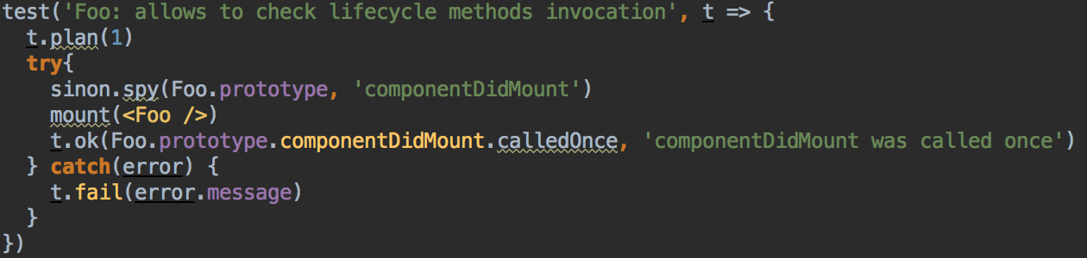
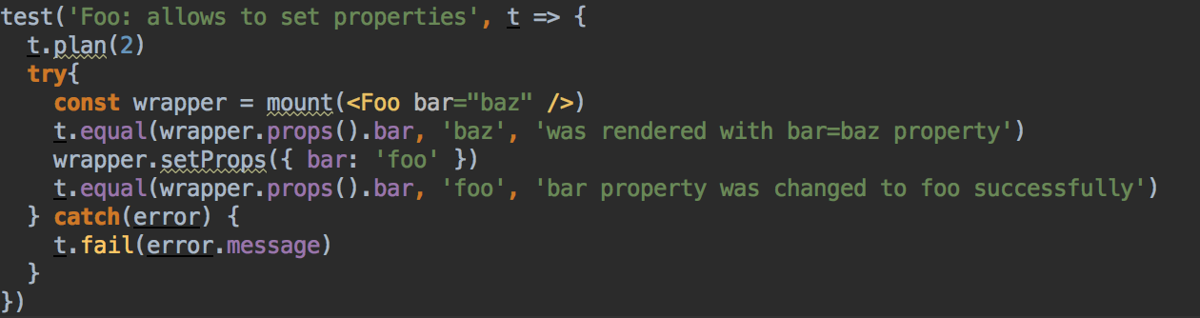
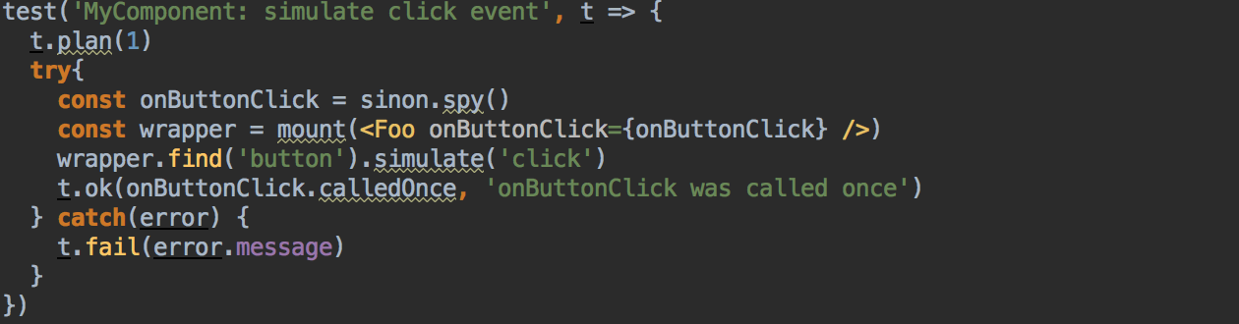
ENZYME MOUNT RENDERING API EXAMPLES
Notes:
Because every React component produces html based on props and state, this makes testing React code significantly easier than it would otherwise be.
Web Hypertext Application Technology Working Group (WHATWG)
When we need jsdom?
in case React component uses window/document, includes refs or uses ReactDOM

Slide 22
ENZYME STATIC RENDERING API render
Used to render react components to static HTML and analyze the resulting HTML structure
Uses a third party HTML parsing and traversal library Cheerio

Slide 23
HANDS-ON
Clone the repository
git clone https://github.com/kiragona/react-redux-test-workshop.git
Install dev dependencies
npm install or yarn install
Run the application
npm start or yarn start

Slide 24
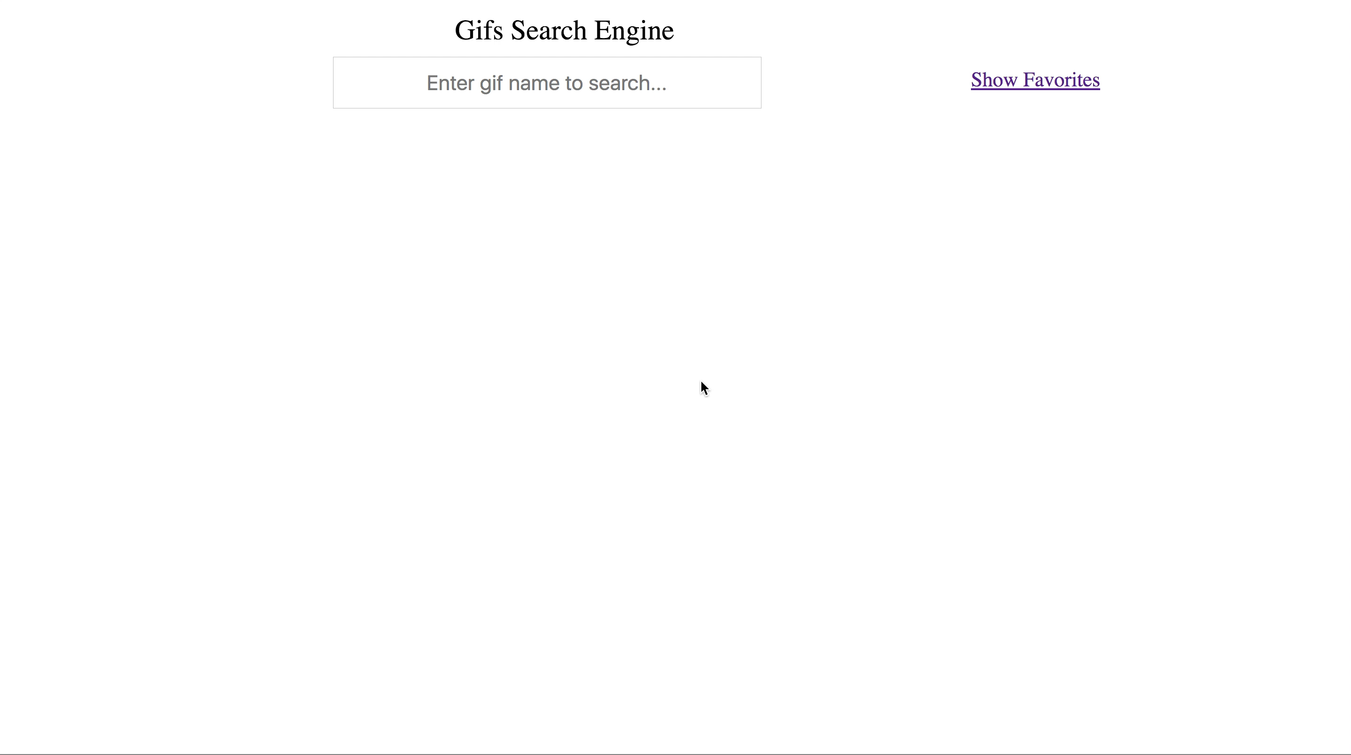
Gifs Engine Search Application
Search gifs using Giphy API
Display results
Show selected gif details in modal dialog
Enable to choose favorite gif
Display favorites gifs list

Slide 25
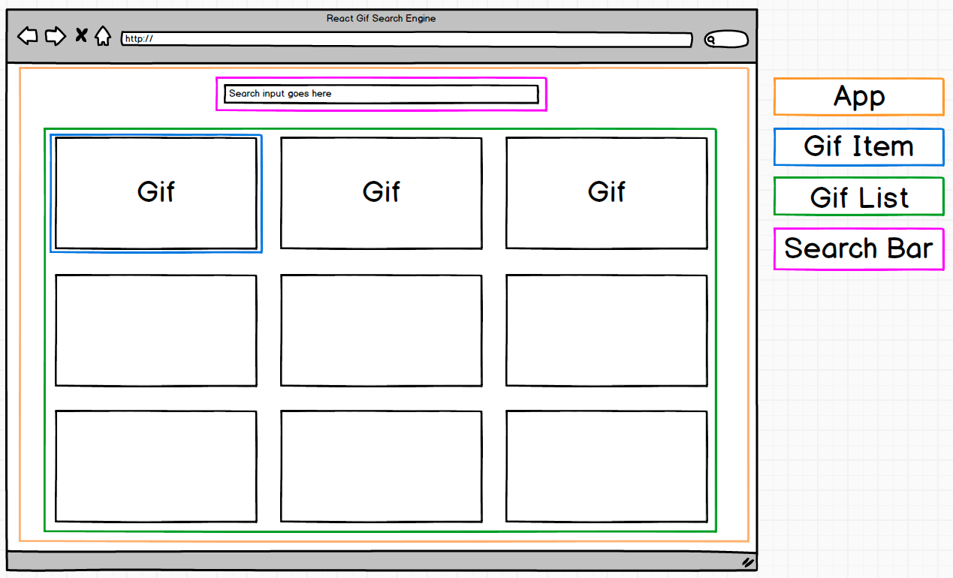
Gifs Search Engine App: components
Show Favorites
Gif Details Modal
Gif Modal
Favorites

Slide 26
SETUP TEST ENVIRONMENT
"devDependencies": { …
"babel-plugin-istanbul": "^4.1.4", "babel-polyfill": "^6.23.0", "babel-register": "^6.24.1",
…
"tape": "^4.8.0",
"tap-spec": "^4.1.1", "jsdom": "^11.7.0",
"enzyme": "^2.9.1",
"react-test-renderer": "^15.6.1", …
}
package.json
Notes:
'react-dom@15.5+ and react-test-renderer are implicit dependencies when using ' + 'react@15.5+ with enzyme

Slide 27
TEST RUNNING CONFIGURATION
package.json : command to run tests
"scripts": { "test": "tape -r babel-register -r babel-polyfill \"{test/integration,src}/**/*.spec.js\" --tap | tap-spec" }
.babelrc (next to package.json)
…
"env": { "test": { "plugins": [ "istanbul" ] } }
Notes:
A babel plugin that adds istanbul instrumentation to ES6 code
computes statement, line, function and branch coverage
tap-spec - Formatted TAP output like Mocha's spec reporter

Slide 28
TAPE TEST SKELETON
Add new file GifItem.spec.js next to GifItem.js
Lets write first test skeleton:
import test from 'tape’
test('GifItem: rendering', t => { // number of assertions to be run
t.plan(1)
try { t.ok(true, 'dummy test ok') } catch (e) { t.fail(e.message) } })
test() creates a new test with an optional name string and optional opts object
CB (t) fires with the new test object t once all preceding tests have finished
Tests are executed serially
t.plan(n) : Declare n of assertions that should be run
Notes:
Test GifItem React component

Slide 29
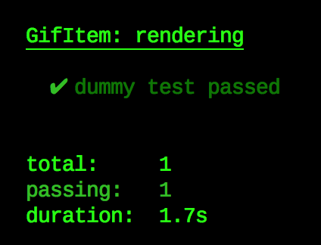
RUN FIRST DUMMY TEST
yarn test or npm test preceding

Slide 30
TEST GIFITEM REACT COMPONENT
What to test?
import React, {Component} from 'react' class GifItem extends Component { render() { const {onGifSelect, gif} = this.props return ( <div className="gif-item" onClick={() => { onGifSelect(gif) }}> <img alt='' src={gif.images.downsized.url}/> </div> ) } } export default GifItem
check that element with ‘gif-item’ class was rendered

Slide 31
TEST GIFITEM REACT COMPONENT - continue
Render GifItem component as expected
import test from 'tape' import {shallow} from 'enzyme' import GifItem from './GifItem' import React from 'react' test('GifItem: rendering’, t => { t.plan(1) try { const wrapper = shallow(<GifItem/>) const gifItemDiv = wrapper.find('.gif-item') t.equal(gifItemDiv.length , 1 , 'GifItem was rendered') } catch (e) { t.fail(e.message) } })
shallow(node[, options]) => ShallowWrapper
node (ReactElement) - the node to render
Returns ShallowWrapper instance around the rendered output.
.find(selector) =>ShallowWrapper
selector (EnzymeSelector) - the selector to match.
Returns ShallowWrapper - a new wrapper that wraps the found nodes.
Notes:
import test from 'tape' import {shallow} from 'enzyme' import GifItem from './GifItem' import React from 'react' test('GifItem: rendering', t => { t.plan(1) try { const wrapper = shallow(<GifItem/>) const gifItemDiv = wrapper.find('.gif-item') t.equal(gifItemDiv.length, 1, 'GifItem was rendered') }catch (e) { t.fail(e.message) } })

Slide 32
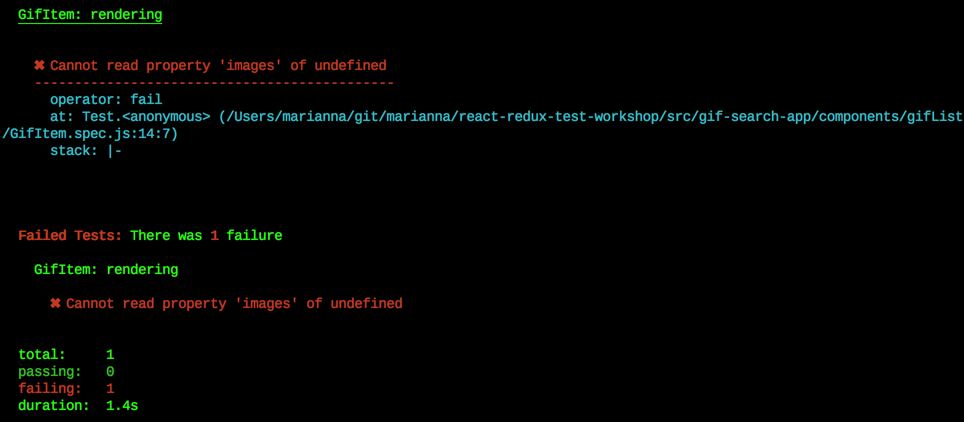

RUN TEST…
OOPS…

Slide 33
INVESTIGATE GifItem CODE PROBLEM
import React, {Component} from 'react' class GifItem extends Component { render() {
const {onGifSelect, gif} = this.props
return ( <div className="gif-item" onClick={() => { onGifSelect(gif) }}>
<img alt='' src={gif.images.downsized.url}/>
</div> ) } }
Notes:
import {test} from 'tape' import {shallow} from 'enzyme' import React from 'react' import GifItem from './GifItem' test('GifItem: rendering without required props', t => { t.plan(2) try { const wrapper = shallow(<GifItem/>) const mainDivElement = wrapper.find('.gif-item') t.equals(mainDivElement.length, 1, 'should render one GifItem component') const gifImgElement = wrapper.find('.gif-img') t.equals(gifImgElement.length, 0, 'should not render gif image, when no gif prop is provided') } catch (e) { t.fail(e.message) t.end() } }) test('GifItem: rendering with required props', t => { t.plan(2) try { const gifMock = { images: { downsized: { url: 'Url' } } } const wrapper = shallow(<GifItem gif={gifMock}/>) const mainDivElement = wrapper.find('.gif-item') t.equals(mainDivElement.length, 1, 'should render one GifItem component') const gifImgElement = wrapper.find('.gif-img') t.equals(gifImgElement.length, 1, 'should render gif image, when gif prop is provided') } catch (e) { t.fail(e.message) t.end() } })

Slide 34
FIX GifItem CODE PROBLEM
import React, {Component} from 'react' import PropTypes from 'prop-types' class GifItem extends Component { static propTypes = { gif: PropTypes.object.isRequired, // better to define shape onGifSelect: PropTypes.func } selectGif = () => { const {onGifSelect, gif} = this.props if (onGifSelect) { onGifSelect(gif) } } render() { const {gif} = this.props if (!gif || typeof gif !== 'object’) { // note: this is a very naive validation return ( <div className="gif-item"/> ) }
return ( <div className="gif-item" onClick={this.selectGif}> <img className='gif-img' alt='' src={gif.images.downsized.url}/> </div> ) } }
Add PropTypes
Check Properties existence
Notes:
import React, {Component} from 'react' import PropTypes from 'prop-types' class GifItem extends Component { static propTypes = { gif: PropTypes.object.isRequired, // better to define shape onGifSelect: PropTypes.func } selectGif = () => { const {onGifSelect, gif} = this.props if (onGifSelect) { onGifSelect(gif) } } render() { const {gif} = this.props // note: this is a very naive validation if (!gif || typeof gif !== 'object') { return ( <div className="gif-item"/> ) } return ( <div className="gif-item" onClick={this.selectGif}> <img className='gif-img' alt='' src={gif.images.downsized.url}/> </div> ) } } export default GifItem

Slide 35
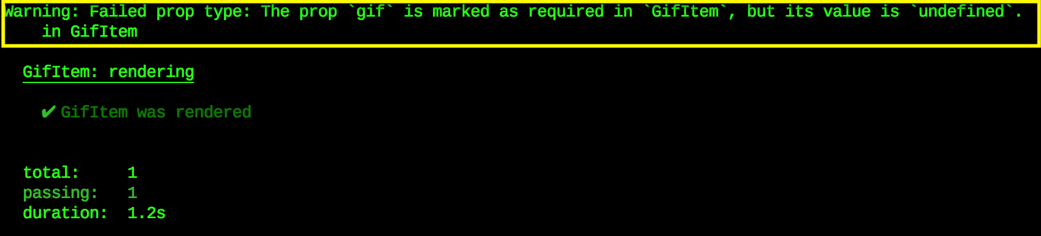
RUN test again…
Notes:
import {test} from 'tape' import {shallow} from 'enzyme' import React from 'react' import GifItem from './GifItem' test('GifItem: rendering without required props', t => { t.plan(2) try { const wrapper = shallow(<GifItem/>) const mainDivElement = wrapper.find('.gif-item') t.equals(mainDivElement.length, 1, 'should render one GifItem component') const gifImgElement = wrapper.find('.gif-img') t.equals(gifImgElement.length, 0, 'should not render gif image, when no gif prop is provided') } catch (e) { t.fail(e.message) t.end() } }) test('GifItem: rendering with required props', t => { t.plan(2) try { const gifMock = { images: { downsized: { url: 'Url' } } } const wrapper = shallow(<GifItem gif={gifMock}/>) const mainDivElement = wrapper.find('.gif-item') t.equals(mainDivElement.length, 1, 'should render one GifItem component') const gifImgElement = wrapper.find('.gif-img') t.equals(gifImgElement.length, 1, 'should render gif image, when gif prop is provided') } catch (e) { t.fail(e.message) t.end() } })

Slide 36
TEST onGifSelect CB INVOCATION
use sinon – standalone test spies, stubs and mocks for JavaScript
.simulate(event[, ...args]) =>Self
Simulates evens :
event (String): The event name to be simulated
...args (Any [optional]): A mock event object that will get passed through to the event handlers.
import sinon from 'sinon' import {gif1} from '../../../../test/mocks/dataMocks' test('GifItem: onGifSelect invocation', t => { t.plan(1) try {
const onGifSelectSpy = sinon.spy() const wrapper = shallow(<GifItem onGifSelect={onGifSelectSpy} gif={gif1}/>) const gifItemDiv = wrapper.find('.gif-item') gifItemDiv.simulate('click') t.ok(onGifSelectSpy.calledOnce, 'onGifSelect was invoked on gif click’)
t.deepEqual(onGifSelectSpy.args[0][0], gif1, 'was called with expected arguments’)
} catch (e) { t.fail(e.message) } })
Notes:
test('GifItem: onGifSelect invocation', t => { t.plan(2) try { const onGifSelectSpy = sinon.spy() const wrapper = shallow(<GifItem onGifSelect={onGifSelectSpy} gif={gif1}/>) const gifItemDiv = wrapper.find('.gif-item') gifItemDiv.simulate('click') t.ok(onGifSelectSpy.calledOnce, 'onGifSelect was invoked on gif click') t.deepEqual(onGifSelectSpy.args[0][0], gif1, 'was called with expected arguments') }catch (e) { t.fail(e.message) } })

Slide 37
TEST COVERAGE : nyc
Use nyc - the Istanbul command line interface
Configuration: in package.json
"scripts": {
… "coverage": "nyc --check-coverage npm test",
… }
"nyc": { "statements": 90, "branches": 85, "functions": 90, "lines": 90, "reporter": [ "text", "lcov", "text-summary" ], "exclude": [ "**/*.spec.js", "test/**/*.js" ], "cache": true }
Notes:
1. Accurate stack traces using source-maps
When produce-source-map is set to true, then the instrumented source files will include inline source maps for the instrumenter transform. When combined with source-map-support, stack traces for instrumented code will reflect their original lines.
2. Support for custom require hooks (babel, typescript, etc.)
nyc supports custom require hooks like babel-register. nyc can load the hooks for you, using the --require flag.
Source maps are used to map coverage information back to the appropriate lines of the pre-transpiled code. You'll have to configure your custom require hook to inline the source-map in the transpiled code. For Babel that means setting the sourceMaps option to inline.
3. Source-Map support for pre-instrumented codebases
If you opt to pre-instrument your source-code (rather than using a just-in-time transpiler like babel-register) nyc supports both inline source-maps and .map files.
Important: If you are using nyc with a project that pre-instruments its code, run nyc with the configuration option --exclude-after-remap set to false. Otherwise nyc's reports will exclude any files that source-maps remap to folders covered under exclude rules.
Use with babel-plugin-istanbul for Babel Support
We recommend using babel-plugin-istanbul if your project uses the babel tool chain:
enable the babel-plugin-istanbul plugin:
{"babel": {"presets": ["env"],"env": {"test": {"plugins": ["istanbul"]}}}}
Note: With this configuration, the Istanbul instrumentation will only be active when NODE_ENV or BABEL_ENV is test.
We recommend using the cross-env package to set these environment variables in your package.json scripts in a way that works cross-platform.
disable nyc's instrumentation and source-maps, e.g. in package.json:
{"nyc": {"require": ["babel-register"],"sourceMap":false,"instrument":false},"scripts": {"test":"cross-env NODE_ENV=test nyc mocha"}}
That's all there is to it, better ES2015+ syntax highlighting awaits:
Support for alternate file extensions (.jsx, .mjs)
Supporting file extensions can be configured through either the configuration arguments or with the nyc config section in package.json.
nyc --extension .jsx --extension .mjs npmtest
{"nyc": {"extension": [".jsx",".mjs"]}}
Checking coverage
nyc can fail tests if coverage falls below a threshold. After running your tests with nyc, simply run:
nyc check-coverage --lines 95 --functions 95 --branches 95
nyc also accepts a --check-coverage shorthand, which can be used to both run tests and check that coverage falls within the threshold provided:
nyc --check-coverage --lines 100 npmtest
The above check fails if coverage falls below 100%.
To check thresholds on a per-file basis run:
nyc check-coverage --lines 95 --per-file
Running reports
Once you've run your tests with nyc, simply run:
nyc report
To view your coverage report:
You can use any reporters that are supported by istanbul: clover, cobertura, html, json-summary, json, lcov, lcovonly, none, teamcity, text-lcov, text-summary, text.
nyc report --reporter=lcov
You can find examples of the output for various reporters here.

Slide 38
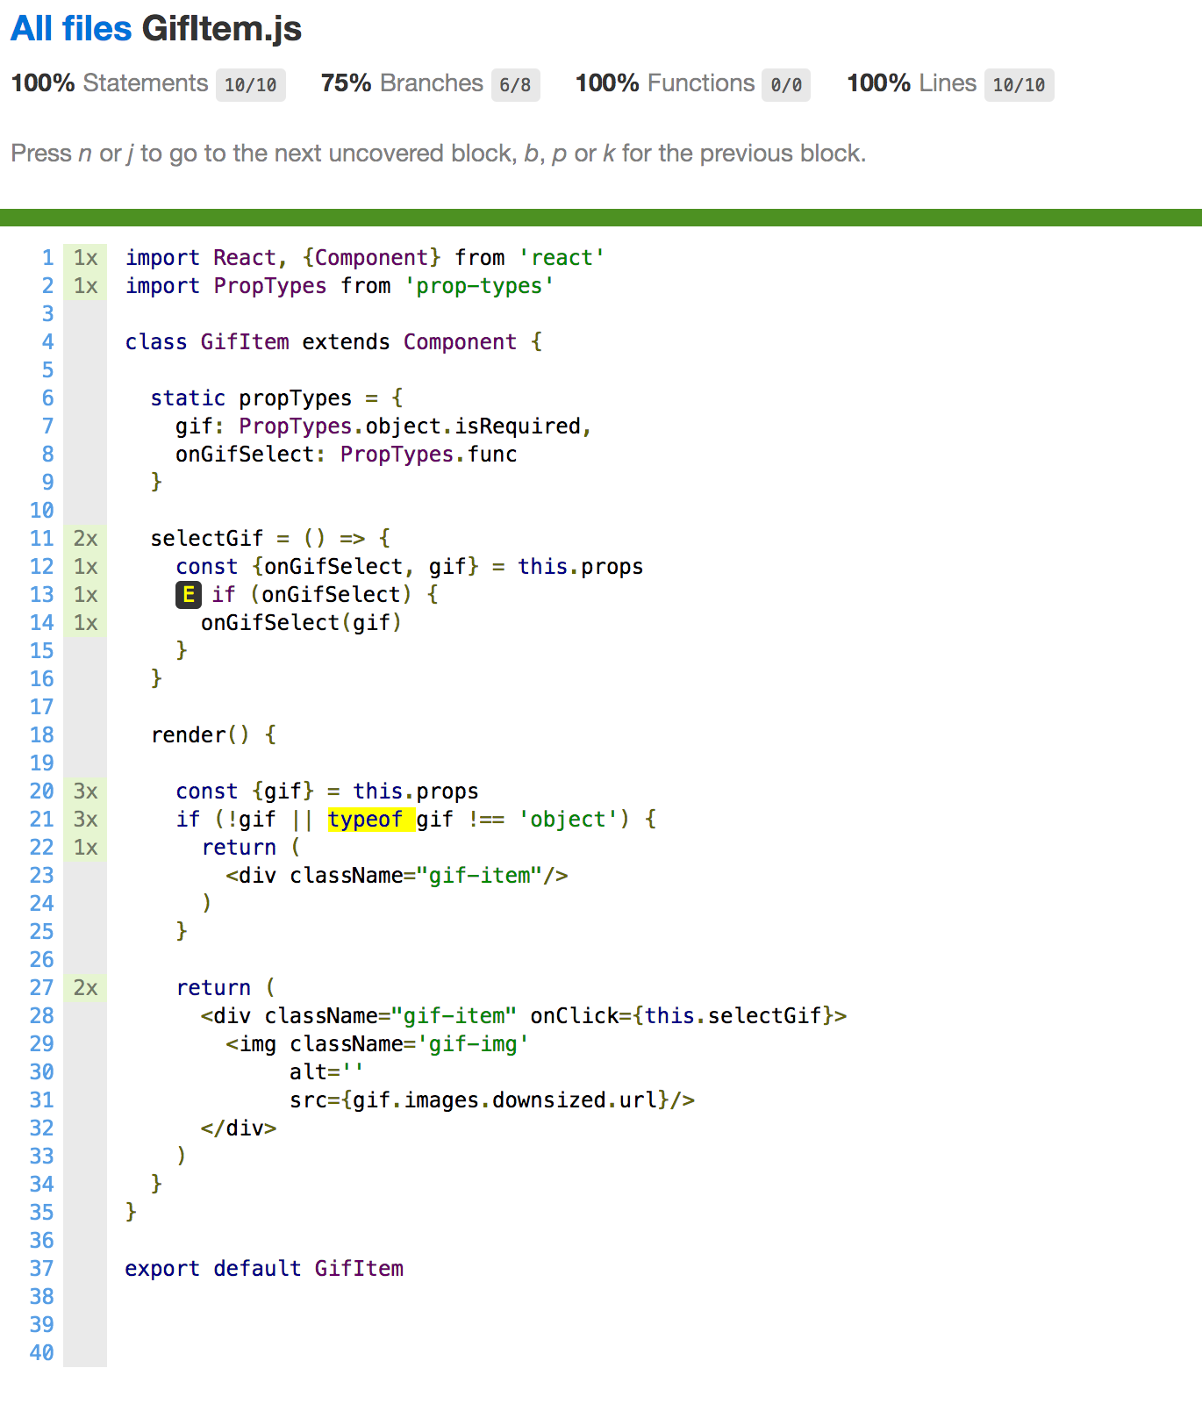
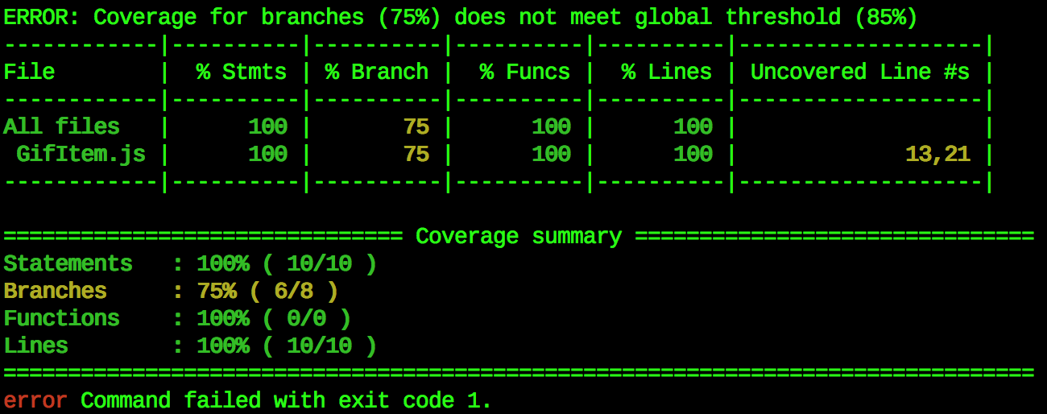
TEST COVERAGE REPORT
yarn coverage or npm run coverage
Notes:
1. Accurate stack traces using source-maps
When produce-source-map is set to true, then the instrumented source files will include inline source maps for the instrumenter transform. When combined with source-map-support, stack traces for instrumented code will reflect their original lines.
2. Support for custom require hooks (babel, typescript, etc.)
nyc supports custom require hooks like babel-register. nyc can load the hooks for you, using the --require flag.
Source maps are used to map coverage information back to the appropriate lines of the pre-transpiled code. You'll have to configure your custom require hook to inline the source-map in the transpiled code. For Babel that means setting the sourceMaps option to inline.
3. Source-Map support for pre-instrumented codebases
If you opt to pre-instrument your source-code (rather than using a just-in-time transpiler like babel-register) nyc supports both inline source-maps and .map files.
Important: If you are using nyc with a project that pre-instruments its code, run nyc with the configuration option --exclude-after-remap set to false. Otherwise nyc's reports will exclude any files that source-maps remap to folders covered under exclude rules.
Use with babel-plugin-istanbul for Babel Support
We recommend using babel-plugin-istanbul if your project uses the babel tool chain:
enable the babel-plugin-istanbul plugin:
{"babel": {"presets": ["env"],"env": {"test": {"plugins": ["istanbul"]}}}}
Note: With this configuration, the Istanbul instrumentation will only be active when NODE_ENV or BABEL_ENV is test.
We recommend using the cross-env package to set these environment variables in your package.json scripts in a way that works cross-platform.
disable nyc's instrumentation and source-maps, e.g. in package.json:
{"nyc": {"require": ["babel-register"],"sourceMap":false,"instrument":false},"scripts": {"test":"cross-env NODE_ENV=test nyc mocha"}}
That's all there is to it, better ES2015+ syntax highlighting awaits:
Support for alternate file extensions (.jsx, .mjs)
Supporting file extensions can be configured through either the configuration arguments or with the nyc config section in package.json.
nyc --extension .jsx --extension .mjs npmtest
{"nyc": {"extension": [".jsx",".mjs"]}}
Checking coverage
nyc can fail tests if coverage falls below a threshold. After running your tests with nyc, simply run:
nyc check-coverage --lines 95 --functions 95 --branches 95
nyc also accepts a --check-coverage shorthand, which can be used to both run tests and check that coverage falls within the threshold provided:
nyc --check-coverage --lines 100 npmtest
The above check fails if coverage falls below 100%.
To check thresholds on a per-file basis run:
nyc check-coverage --lines 95 --per-file
Running reports
Once you've run your tests with nyc, simply run:
nyc report
To view your coverage report:
You can use any reporters that are supported by istanbul: clover, cobertura, html, json-summary, json, lcov, lcovonly, none, teamcity, text-lcov, text-summary, text.
nyc report --reporter=lcov
You can find examples of the output for various reporters here.

Slide 39

TIME TO
: TEST FavoriteStar COMPONENT
import React, {Component} from 'react' import PropTypes from 'prop-types' export default class FavoriteStar extends Component { static propTypes = { isFavorite: PropTypes.bool, onFavoriteChange: PropTypes.func } static defaultProps = { isFavorite: false } handleClick = () => { if (this.props.onFavoriteChange) { this.props.onFavoriteChange(!this.props.isFavorite) } } render() { let starClassName = (this.props.isFavorite) ? 'star-favorite' : 'star' return ( <div className={starClassName} onClick={this.handleClick}/> ) } }
Suggested Test Plan:
Rendering according isFavorite property
onFavoriteChange CB invocation with proper params
Hints:
Use sinon spy to check onFavoriteChange CB
Use sinon spyCall.args API to check CB invocation params
Notes:
import test from 'tape' import {shallow} from 'enzyme' import FavoriteStar from './FavoriteStar' import React from 'react' import sinon from 'sinon' test('FavoriteStar: rendering regular start', t => { t.plan(1) try { const wrapper = shallow(<FavoriteStar/>) t.equals(wrapper.find('.star').length, 1, 'should render regular star') } catch (error) { t.fail(error.message) } }) test('FavoriteStar: rendering favorite star', t => { t.plan(1) try { const wrapper = shallow(<FavoriteStar isFavorite/>) t.equals(wrapper.find('.star-favorite').length, 1, 'should render favorite star') } catch (error) { t.fail(error.message) } }) test('FavoriteStar: check onFavoriteChange CB invocation', t => { t.plan(2) try { const onFavoriteChangeSpy = sinon.spy() const wrapper = shallow(<FavoriteStar onFavoriteChange={onFavoriteChangeSpy}/>) const mainDivElement = wrapper.find('.star') mainDivElement.simulate('click') t.ok(onFavoriteChangeSpy.calledOnce, 'onFavoriteChange was called once') t.equals(onFavoriteChangeSpy.args[0][0], true, 'onFavoriteChange was called with correct args') } catch (error) { t.fail(error.message) } })

Slide 40
HOW TO TEST COMPONENT’s METHODS
import React, {Component} from 'react' import PropTypes from 'prop-types' export default class FavoriteStar extends Component { static propTypes = { isFavorite: PropTypes.bool, onFavoriteChange: PropTypes.func } static defaultProps = { isFavorite: false } handleClick = () => { if (this.props.onFavoriteChange) { this.props.onFavoriteChange(!this.props.isFavorite) } } render() { let starClassName = (this.props.isFavorite) ? 'star-favorite' : 'star' return ( <div className={starClassName} onClick={this.handleClick}/> ) } }
Notes:
import test from 'tape' import {shallow} from 'enzyme' import FavoriteStar from './FavoriteStar' import React from 'react' import sinon from 'sinon’
test('FavoriteStar: handleClick method', t => { t.plan(1) try { const wrapper = shallow(<FavoriteStar />) wrapper.instance().handleClick() t.pass('handleClick method works properly when no onFavoriteChange CB is provided') } catch (error) { t.fail(error.message) } }) test('FavoriteStar: rendering regular start', t => { t.plan(1) try { const wrapper = shallow(<FavoriteStar/>) t.equals(wrapper.find('.star').length, 1, 'should render regular star') } catch (error) { t.fail(error.message) } }) test('FavoriteStar: rendering favorite star', t => { t.plan(1) try { const wrapper = shallow(<FavoriteStar isFavorite/>) t.equals(wrapper.find('.star-favorite').length, 1, 'should render favorite star') } catch (error) { t.fail(error.message) } }) test('FavoriteStar: check onFavoriteChange CB invocation', t => { t.plan(2) try { const onFavoriteChangeSpy = sinon.spy() const wrapper = shallow(<FavoriteStar onFavoriteChange={onFavoriteChangeSpy}/>) const mainDivElement = wrapper.find('.star') mainDivElement.simulate('click') t.ok(onFavoriteChangeSpy.calledOnce, 'onFavoriteChange was called once') t.equals(onFavoriteChangeSpy.args[0][0], true, 'onFavoriteChange was called with correct args') } catch (error) { t.fail(error.message) } })

Slide 41
TEST handleClick METHOD of FavoriteStar
test('FavoriteStar: handleClick method', t => { t.plan(1) try { const wrapper = shallow(<FavoriteStar />)
wrapper.instance().handleClick()
t.pass('handleClick method works properly when no onFavoriteChange CB is provided’)
} catch (error) { t.fail(error.message) } })
.instance() => ReactComponent
Returns the react component instance
Notes:
test('FavoriteStar: handleClick method', t => { t.plan(1) try { const wrapper = shallow(<FavoriteStar />) wrapper.instance().handleClick() t.pass('handleClick method works properly when no onFavoriteChange CB is provided') } catch (error) { t.fail(error.message) } })

Slide 42
TEST Favorites COMPONENT
Add new file Favorites.spec.js next to Favorites.js
Lets write dummy test:
import test from 'tape’
import {shallow} from 'enzyme' import React from 'react’
import Favorites from './Favorites'
test.only('Favorites: rendering', t => {
t.plan(1) try {
shallow(<Favorites/>) t.ok(true, 'dummy test ok') } catch (e) { t.fail(e.message) } })
Run test: yarn test or npm test
Notes:
import test from 'tape' import {shallow} from 'enzyme' import React from 'react' import Favorites from './Favorites' test.only('Favorites: rendering', t => { t.plan(1) try { shallow(<Favorites/>) t.ok(true, 'dummy test ok') } catch (e) { t.fail(e.message) } })

Slide 43

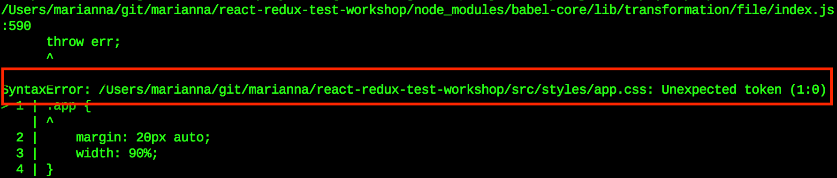
RUN DUMMY Favorites TEST RESULT

Slide 44

WHY LIKE THIS?
Hmm…

Slide 45
SOLUTION 1:
Use 'proxyquire' to mock a CSS files
const proxyquire = require('proxyquire').noCallThru()
proxyquire('../../../styles/app.css’, {})

Slide 46
SOLUTION 2:
Use 'mock-css-modules' to mock CSS files
Uncomment the below lines in: test/utils/index.js
const mockCssModules = require('mock-css-modules') mockCssModules.register(['.css', '.less', '.scss'])

Slide 47
UPDATE DUMMY Favorites TEST
Add test utils import:
import test from 'tape’
import '../../../../test/utils’
import {shallow} from 'enzyme' import React from 'react’
import Favorites from './Favorites'
test.only('Favorites: rendering', t => {
t.plan(1) try {
shallow(<Favorites/>) t.ok(true, 'dummy test ok') } catch (e) { t.fail(e.message) } })
Notes:
import test from 'tape' import '../../../../test/utils' import {shallow} from 'enzyme' import Favorites from './Favorites' import React from 'react' test.only('Favorites: rendering', t => { t.plan(1) try { shallow(<Favorites/>) t.ok(true, 'dummy test ok') } catch (e) { t.fail(e.message) } })

Slide 48
CONTINUE Favorite COMPONENT TESTS
Test rendering of all child component : GifList, GifModal, Link
use wrapper.find() to verify child components existence
Test isFavoriteGif method
wrapper.instance() can be useful here
Test openModal method invocation ‘onGifSelect’
use shallowWrapper.prop(key) that returns the prop value for the root node of the wrapper
use sinon.spy() to verify that CB was invoked
Test closeModal was invoked from GifModal ‘onRequestClose’
Notes:
import test from 'tape' import {shallow} from 'enzyme' import React from 'react' import sinon from 'sinon' import '../../../../test/utils' import {gif1, gif3, favoritesMap} from '../../../../test/mocks/dataMocks' import GifList from '../gifList/GifList' import GifModal from '../gifModal/GifModal' import {Link} from 'react-router' import Favorites from './Favorites' test('Favorites: rendering', t => { t.plan(5) try { const wrapper = shallow(<Favorites selectedGif={gif1}/>) t.equal(wrapper.find('.app').length, 1, 'should render one Favorites component') t.equal(wrapper.find('.appTitle').text(), 'My Favorites Gifs', 'should render correct Favorites title component') t.equal(wrapper.find(GifList).length, 1, 'should render one GifList component') t.equal(wrapper.find(GifModal).length, 1, 'should render one GifModal component') t.equal(wrapper.find(Link).length, 1, 'should render one Link component') } catch (e) { t.fail(e.message) } }) test('Favorites: test openModal CB invocation', t => { t.plan(1) try { const props = { selectedGif: gif1, favoriteGifIdsMap: favoritesMap, openModal: sinon.spy() } const wrapper = shallow(<Favorites {...props}/>) //check openModal invocation wrapper.find(GifList).prop('onGifSelect')() t.ok(props.openModal.calledOnce, 'open modal was invoked from GifList on select gif') } catch (e) { t.fail(e.message) } }) test('Favorites: test closeModal CB invocation', t => { t.plan(1) try { const props = { selectedGif: gif1, favoriteGifIdsMap: favoritesMap, closeModal: sinon.spy() } const wrapper = shallow(<Favorites {...props}/>) //check close modal invocation wrapper.find(GifModal).prop('onRequestClose')() t.ok(props.closeModal.calledOnce, 'close modal was invoked from GifModal') } catch (e) { t.fail(e.message) } }) test('Favorites: test isFavoriteGif method', t => { t.plan(3) try { const props = { selectedGif: gif1, favoriteGifIdsMap: favoritesMap, setFavoriteGif: sinon.spy() } const wrapper = shallow(<Favorites {...props}/>) let res = wrapper.instance().isFavoriteGif(null, favoritesMap) t.ok(!res, 'isFavoriteGif return correct output for null input as selected gif') res = wrapper.instance().isFavoriteGif(gif3, favoritesMap) t.ok(!res, 'isFavoriteGif return correct output for not favorite gif') res = wrapper.instance().isFavoriteGif(gif1, favoritesMap) t.ok(res, 'isFavoriteGif return correct output for favorite gif') } catch (e) { console.log(e.stack) t.fail(e.message) } } ) test('Favorites: test handleGifSelection method', t => { t.plan(2) try { let wrapper = shallow(<Favorites />) wrapper.instance().handleGifSelection(gif1) t.pass('handleGifSelection works properly when no openModal CB is provided') const props = { selectedGif: gif1, favoriteGifIdsMap: favoritesMap, openModal: sinon.spy() } wrapper = shallow(<Favorites {...props}/>) wrapper.instance().handleGifSelection(gif1) t.ok(props.openModal.calledOnce, 'handleGifSelection works properly when openModal CB is provided') } catch (e) { console.log(e.stack) t.fail(e.message) } } ) test('Favorites: test onCloseModal method', t => { t.plan(2) try { let wrapper = shallow(<Favorites />) wrapper.instance().onCloseModal(gif1) t.pass('onCloseModal works properly when no closeModal CB is provided') const props = { selectedGif: gif1, favoriteGifIdsMap: favoritesMap, closeModal: sinon.spy() } wrapper = shallow(<Favorites {...props}/>) wrapper.instance().onCloseModal(gif1) t.ok(props.closeModal.calledOnce, 'handleGifSelection works properly when closeModal CB is provided') } catch (e) { console.log(e.stack) t.fail(e.message) } } )

Slide 49
AGENDA
Intro
Why ?
What ?
Testing Guidelines
How
Test Environment
Hands-On
React Component (git checkout react_components_testing)
Redux: Action, Reducer, Container
Integration Test
- Redux: Action, Reducer, Container

Slide 50
REDUX DATA FLOW
Action
Middleware
Reducer
Action Creator
App Store
Outside action
(push,AJAX,callbacks, etc’)
Components (Views)
Notes:
Reducers are just pure functions that take the previous state and an action, and return the next state.
Remember to return new state objects, instead of mutating the previous state.
You can start with a single reducer, and as your app grows, split it off into smaller reducers that manage specific parts of the state tree.
Because reducers are just functions, you can control the order in which they are called, pass additional data, or even make reusable reducers for common tasks such as pagination.
Your reducers should never mutate the state directly, but instead create a copy of the state object, modify it, and return it back. (We will talk about this in more detail later on when we start writing reducers.)
This ensures that neither the views nor the network callbacks will ever write directly to the state. Instead, they express an intent to transform the state.
Because all changes are centralized and happen one by one in a strict order, there are no subtle race conditions to watch out for.
As actions are just plain objects, they can be logged, serialized, stored, and later replayed for debugging or testing purposes.
Your application shouldn't write to the state tree directly; instead, you dispatch an action, or an object that expresses your intent to mutate the store.

Slide 51
REDUX APP STRUCTURE
ROOT REDUCER
APP STORE
gifsActions
gifsReducer
data: []
modalActions
modalReducer
gif: object
modalIsOpen: bool
favoriteGifIdsMap : Map
favoritesActions
favoritesReducer
Notes:
Reducers are just pure functions that take the previous state and an action, and return the next state.
Remember to return new state objects, instead of mutating the previous state.
You can start with a single reducer, and as your app grows, split it off into smaller reducers that manage specific parts of the state tree.
Because reducers are just functions, you can control the order in which they are called, pass additional data, or even make reusable reducers for common tasks such as pagination.
Your reducers should never mutate the state directly, but instead create a copy of the state object, modify it, and return it back. (We will talk about this in more detail later on when we start writing reducers.)
This ensures that neither the views nor the network callbacks will ever write directly to the state. Instead, they express an intent to transform the state.
Because all changes are centralized and happen one by one in a strict order, there are no subtle race conditions to watch out for.
As actions are just plain objects, they can be logged, serialized, stored, and later replayed for debugging or testing purposes.
Your application shouldn't write to the state tree directly; instead, you dispatch an action, or an object that expresses your intent to mutate the store.

Slide 52
TEST FavoritesContainer
import {connect} from 'react-redux' import {bindActionCreators} from 'redux' import {setFavoriteGif} from '../actions/favoritesActions' import {closeModal, openModal} from '../actions/modalActions' import Favorites from '../components/favorites/Favorites' function mapDispatchToProps(dispatch) { return { setFavoriteGif: bindActionCreators(setFavoriteGif, dispatch), closeModal: bindActionCreators(closeModal, dispatch), openModal: bindActionCreators(openModal, dispatch) } } function mapStateToProps(state) { return { favoriteGifIdsMap: state.favorites.favoriteGifIdsMap, modalIsOpen: state.modal.modalIsOpen, selectedGif: state.modal.gif } } export default connect(mapStateToProps, mapDispatchToProps)(Favorites)
verify connecting React Component to Redux Store
Notes:
NOTE: we cannot use shallow API, since we connect Favorites component using react-redux function, that not renders Favorites component but wraps it

Slide 53
import {mount} from 'enzyme' import React from 'react' import test from 'tape' import {Provider} from 'react-redux' import configureStore from '../store/configureStore' import {favoritesMap} from '../../../test/mocks/dataMocks' import {createInitialAppState} from '../store/rootReducer' import FavoritesContainer from './FavoritesContainer' test.only('FavoritesContainer: test connection to Redux store', t => { t.plan(1) try { const store = configureStore(createInitialAppState(null, favoritesMap)) const wrapper = mount( <Provider store={store}> <FavoritesContainer store={store}/> </Provider> )
t.equal(wrapper.find('.gif-item').length, 2, 'should render 2 gifs') } catch (e) { t.fail(e.message) } } )
Use mount API, since react-redux connect method wraps Favorite Component, so we could not find it using Shallow Wrapper
Create store: createInitialAppState
We mount react-redux Provider with FavoritesContainer as child component to enable passing App Store to child component and mapping state to props
FavoritesContainer.spec.js
Notes:
import {mount} from 'enzyme' import React from 'react' import test from 'tape' import {Provider} from 'react-redux' import configureStore from '../store/configureStore' import {favoritesMap} from '../../../test/mocks/dataMocks' import {createInitialAppState} from '../store/rootReducer' import FavoritesContainer from './FavoritesContainer' test.only('FavoritesContainer: test connection to Redux store', t => { t.plan(1) try { const store = configureStore(createInitialAppState(null, favoritesMap)) const wrapper = mount( <Provider store={store}> <FavoritesContainer store={store}/> </Provider> ) t.equal(wrapper.find('.gif-item').length, 2, 'should render 2 gifs') } catch (e) { t.fail(e.message) } } )

Slide 54

RUN FavoritesContainer TEST:
yarn test or npm test

Slide 55
SOLUTION : configure and use JSDOM
Uncomment the below lines in: test/utils/index.js
const createDom = require('./createDom') module.exports = { createDom }

Slide 56
JSDOM CONFIGURATION
const {JSDOM} = require("jsdom") module.exports = function createDOM() { const dom = new JSDOM('<html><body></body></html>', { url: 'http://api.giphy.com', referrer: 'http://api.giphy.com', }) global.window = dom.window global.document = dom.window.document Object.keys(dom.window).forEach((property) => { if (typeof global[property] === 'undefined') { global[property] = dom.window[property] } }) }
test/utils/createDom/index.js

Slide 57
UPDATE FavoritesContainer TEST:
import {mount} from 'enzyme' import React from 'react' import test from 'tape' import {Provider} from 'react-redux' import configureStore from '../store/configureStore' import {favoritesMap} from '../../../test/mocks/dataMocks' import {createInitialAppState} from '../store/rootReducer' import FavoritesContainer from './FavoritesContainer’
import {createDom} from '../../../test/utils' test.only('FavoritesContainer: test connection to Redux store’, t => { t.plan(1) try { const store = configureStore(createInitialAppState(null, favoritesMap)) createDom() const wrapper = mount( <Provider store={store}> <FavoritesContainer store={store}/> </Provider> )
t.equal(wrapper.find('.gif-item').length, 2, 'should render 2 gifs') } catch (e) { t.fail(e.message) } } )
Import CreateDom from test utils
Create DOM before mount
Notes:
mport {mount} from 'enzyme' import React from 'react' import test from 'tape' import {Provider} from 'react-redux' import configureStore from '../store/configureStore' import {favoritesMap} from '../../../test/mocks/dataMocks' import {createInitialAppState} from '../store/rootReducer' import FavoritesContainer from './FavoritesContainer' import {createDom} from '../../../test/utils' test('FavoritesContainer: test connection to Redux store', async t => { t.plan(1) try { const store = configureStore(createInitialAppState(null, favoritesMap)) await createDom() const wrapper = mount( <Provider store={store}> <FavoritesContainer store={store}/> </Provider> ) t.equal(wrapper.find('.gif-item').length, 2, 'should render 2 gifs') } catch (e) { t.fail(e.message) } } )

Slide 58

TEST ACTION CREATORS
Action is a plain JavaScript object with
type - required
payload - required, if you need pass data within action
Action Creator :
function that create actions
JSHeroes
PRODUCTION
CAMERA:
Marianna g
18/4/18 g
47 g
1 g
READY, SET, ACTION!

Slide 59
TEST favoriesActions CREATOR: favoritesActions.spec.js
import {setFavoriteGif} from './favoritesActions' import test from 'tape' test('Test SET_FAVORITE_GIF action creator', t => { t.plan(1) try { const expectedAction = { type: 'SET_FAVORITE_GIF', gif: {}, isFavorite: true } const actualAction = setFavoriteGif({}, true ) t.deepEquals(actualAction, expectedAction, 'should create SET_FAVORITE_GIF action ') } catch (e) { t.fail(e.message) } })
Notes:
mport {setFavoriteGif} from './favoritesActions' import test from 'tape' test('Test SET_FAVORITE_GIF action creator', t => { t.plan(1) try { const expectedAction = { type: 'SET_FAVORITE_GIF', gif: {}, isFavorite: true } const actualAction = setFavoriteGif({}, true ) t.deepEquals(actualAction, expectedAction, 'should create SET_FAVORITE_GIF action ') } catch (e) { t.fail(e.message) } })

Slide 60
TEST ASYNC ACTION: requestGifs
export function requestGifs(term) {
return (dispatch) => { let url = `${API_URL}${term.replace(/\s/g, '+')}${API_KEY}` return get(url) .then(success) .then((data) => { dispatch(receiveGifs(data)) }) .catch((error) => { dispatch(failedReceiveGifs({
errorMsg: 'error: failed to retrieve gifs’,
reason: error
})) dispatch(receiveGifs([])) }) } }
export const get = (url) => { return window.fetch(url , { method: 'GET', headers: { 'Content-Type': 'application/json' } }) }
export const success = (response) => { return response.json() .then((json) => { return json.data }) .catch(() => (Promise.resolve())) //no resp. body }

Slide 61
TEST ASYNC ACTION: requestGifs
Use nock for HTTP request mocking
Use redux-mock-store for testing redux async action creators

Slide 62
import configureMockStore from 'redux-mock-store’
const middlewares = [thunk] // use thunk from 'redux-thunk’ to define middlewares for our app const mockStore = configureMockStore(middlewares)
test('Test requestGifs ASYNC action: success path', t => { t.plan(1) let nockScope = null try { createDom()
const store = mockStore(initialAppState)
nockScope = nock('http://api.giphy.com') .get('/v1/gifs/search') .query(true) .reply(200, {data: {data: []}})
const expectedActions = [receiveGifs({data: []})] store.dispatch(requestGifs('aaa')) .then(() => { nock.removeInterceptor(nockScope) const actions = store.getActions() t.deepEquals(actions, expectedActions, 'should invoke receiveGifs action on success') }) } catch (e) { nock.removeInterceptor(nockScope) t.fail(e.message) } })
For window.fetch API we need DOM
Use mockStore from ‘redux-mock-store’ to create mocked application store
Mock HTTP request with ‘nock’
Dispatch requestGifs ASYNC action
Reset HTTP Request Mock by nock.removeInterceptor
store.getActions() returns an array of actions, that were dispatched as a result of ASYNC action
Finally compare expected actions to actual
Notes:
import test from 'tape' import {createDom} from '../../../test/utils' import nock from 'nock' import {requestGifs, receiveGifs, failedReceiveGifs} from './gifsActions' import thunk from 'redux-thunk' import initialAppState from '../store/rootReducer' import configureMockStore from 'redux-mock-store' const middlewares = [thunk] const mockStore = configureMockStore(middlewares) test('Test requestGifs ASYNC action: success path', async t => { t.plan(1) let nockScope = null try { await createDom() const expectedActions = [receiveGifs({data: []})] const store = mockStore(initialAppState) nockScope = nock('http://api.giphy.com') .get('/v1/gifs/search') .query(true) .reply(200, {data: {data: []}}) store.dispatch(requestGifs('aaa')) .then(() => { nock.removeInterceptor(nockScope) let actions = store.getActions() t.deepEquals(actions, expectedActions, 'should invoke receiveGifs action on success') }) } catch (e) { nock.removeInterceptor(nockScope) console.log(e.stack) t.fail(e.message) } })

Slide 63
TEST ASYNC ACTION: requestGifs FAILURE PATH
test('Test requestGifs ASYNC action: failure path', t => { t.plan(1) let nockScope = null try { createDom() const store = mockStore(initialAppState)
// mock failure fetch request nockScope = nock('http://api.giphy.com') .get('/v1/gifs/search') .query(true) .reply(500)
const expectedActions = [failedReceiveGifs('error: failed to retrieve gifs', 500), receiveGifs([])] store.dispatch(requestGifs('aaa')) .then(() => { nock.removeInterceptor(nockScope) const actions = store.getActions() t.deepEquals(actions, expectedActions, 'should invoke failedReceiveGifs on failure') }) } catch (e) { nock.removeInterceptor(nockScope) t.fail(e.message) } })
Mock HTTP request using ‘nock’
with failure response
Notes:
test('Test requestGifs ASYNC action: failure path', t => { t.plan(1) let nockScope = null try { createDom() const store = mockStore(initialAppState) nockScope = nock('http://api.giphy.com') .get('/v1/gifs/search') .query(true) .reply(500) const expectedActions = [failedReceiveGifs('error: failed to retrieve gifs', 500), receiveGifs([])] store.dispatch(requestGifs('aaa')) .then(() => { nock.removeInterceptor(nockScope) t.deepEquals(store.getActions(), expectedActions, 'should invoke failedReceiveGifs on failure') }) } catch (e) { nock.removeInterceptor(nockScope) t.fail(e.message) } })

Slide 64
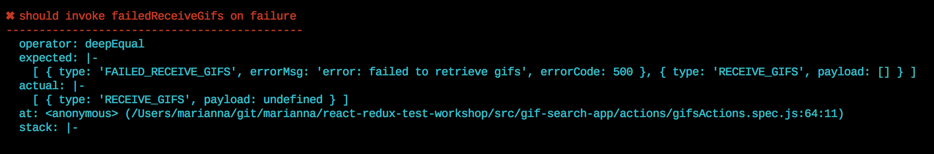

INVESTIGATE requestGifs ACTION CODE PROBLEM
export const success = (response) => { return response.json() .then((json) => { return json.data }) .catch(() => (Promise.resolve())) // Some responses don't contain a body }
OOPS… WE DON’T CHECK HTTP RESPONSE CODE AT ALL

Slide 65
FIX requestGifs ACTION CODE
export const success = (response) => { let responseStatus = response.status if (responseStatus < 400) { // we got one of 'not error' HTTP status response code: see http://www.restapitutorial.com/httpstatuscodes.html return response.json() .then((json) => { return json.data }) } return Promise.reject(response) }

Slide 66

TEST REDUCER
Test for modalReducer
Remember: Reducer is just a function
Just call it and test expected results

Slide 67
TEST modalReducer
import modalReducer from './modalReducer' import {openModal, closeModal} from '../actions/modalActions' import {initialState} from './modalReducer' import test from 'tape' import {gif1} from '../../../test/mocks/dataMocks' test('modalReducer: openModal', t => { t.plan(1) try { const expectedState = {gif: gif1, modalIsOpen: true} const resState = modalReducer(initialState, openModal(gif1, true)) t.deepEqual(expectedState, resState, 'OPEN_MODAL works properly') }catch (e) { t.fail(e.message) } })
Notes:
import modalReducer from './modalReducer' import {openModal, closeModal} from '../actions/modalActions' import {initialState} from './modalReducer' import test from 'tape' import {gif1} from '../../../test/mocks/dataMocks' test('modalReducer: openModal', t => { t.plan(1) try { const expectedState = {gif: gif1, modalIsOpen: true} const resState = modalReducer(initialState, openModal(gif1, true)) t.deepEqual(expectedState, resState, 'OPEN_MODAL works properly') }catch (e) { t.fail(e.message) } })

Slide 68
AGENDA
Intro
Why ?
What ?
Testing Guidelines
How
Test Environment
Hands-On
React Component
Redux: Action, Reducer, Container (git checkout redux_testing)
Integration Test
- Integration Test

Slide 69
INTEGRATION TEST : index.js - routing
import React from 'react' import ReactDOM from 'react-dom' import GifsSearchEngine from './gif-search-app/containers/GifsSearchEngineContainer' import Favorites from './gif-search-app/containers/FavoritesContainer' import {Provider} from 'react-redux' import configureStore from './gif-search-app/store/configureStore' import {Router, Route, browserHistory} from 'react-router' import { syncHistoryWithStore} from 'react-router-redux' const store = configureStore() const history = syncHistoryWithStore(browserHistory, store) ReactDOM.render( <Provider store={store}> <Router history={history}> <Route path="/" component ={GifsSearchEngine}/> <Route path="favorites" component ={Favorites}/> </Router> </Provider>, document.getElementById('app') )
browserHistory from ‘react-router’
Notes:
At load time React determines if it can use DOM, and stores it as a boolean If react is included before JSDOM, we got 'dangerouslyReplaceNodeWithMarkup...' when Component render function returns different type of root element
Solutions: 1. use manual patch : require('fbjs/lib/ExecutionEnvironment').canUseDOM = true 2. Or ensure that you don't load React before you set up JSDOM, which is the only way I'm positive about but it's also the most difficult and bug prone. require('fbjs/lib/ExecutionEnvironment').canUseDOM = true
import test from 'tape' import {createDom} from '../../test/utils/index' import React from 'react' import {Provider} from 'react-redux' import {mount} from 'enzyme' import GifSearchEngineContainer from '../../src/gif-search-app/containers/GifsSearchEngineContainer' import configureStore from '../../src/gif-search-app/store/configureStore' import {createInitialAppState} from '../../src/gif-search-app/store/rootReducer' import Favorites from '../../src/gif-search-app/containers/FavoritesContainer' import {Router, Route, createMemoryHistory} from 'react-router' import {syncHistoryWithStore} from 'react-router-redux' test('Integration Test: Check Routing', t => { t.plan(4) try { createDom() const store = configureStore(createInitialAppState()) const browserHistory = createMemoryHistory('/') const history = syncHistoryWithStore(browserHistory, store) const wrapper = mount( <Provider store={store}> <Router history={history}> <Route path="/" component={GifSearchEngineContainer}/> <Route path="favorites" component={Favorites}/> </Router> </Provider>) let gifEngineView = wrapper.find(GifSearchEngineContainer) let favoritesView = wrapper.find(Favorites) t.equal(gifEngineView.length, 1, 'should render GifSearchEngine View') t.equal(favoritesView.length, 0, 'should NOT render Favorites View') const element = wrapper.find('a') element.simulate('click', {button: 0}) gifEngineView = wrapper.find(GifSearchEngineContainer) favoritesView = wrapper.find(Favorites) t.equal(gifEngineView.length, 0, 'should NOT render GifSearchEngine View after click on \'Show Favorite\'') t.equal(favoritesView.length, 1, 'should render Favorites View after click on \'Show Favorite\'') } catch (e) { console.log(e.stack) t.fail(e.message) t.end() } })

Slide 70
INTEGRATION TEST : routing
import configureStore from './gif-search-app/store/configureStore' import {createInitialAppState} from './gif-search-app/store/rootReducer'
import {Router, Route, createMemoryHistory} from 'react-router’
import {syncHistoryWithStore} from 'react-router-redux’
…
const store = configureStore(createInitialAppState()) const browserHistory = createMemoryHistory('/') const history = syncHistoryWithStore(browserHistory, store)
Use createMemoryHistory from react-router instead of browserHistory
Creates an in-memory history object that does not interact with the browser URL
This is useful when you need to customize the history used for server-side rendering, as well as for automated testing
Notes:
At load time React determines if it can use DOM, and stores it as a boolean If react is included before JSDOM, we got 'dangerouslyReplaceNodeWithMarkup...' when Component render function returns different type of root elemet
Solutions: 1. use manual patch : require('fbjs/lib/ExecutionEnvironment').canUseDOM = true 2. Or ensure that you don't load React before you set up JSDOM, which is the only way I'm positive about but it's also the most difficult and bug prone. require('fbjs/lib/ExecutionEnvironment').canUseDOM = true
import test from 'tape' import {createDom} from '../../test/utils/index' import React from 'react' import {Provider} from 'react-redux' import {mount} from 'enzyme' import GifSearchEngineContainer from '../../src/gif-search-app/containers/GifsSearchEngineContainer' import configureStore from '../../src/gif-search-app/store/configureStore' import {createInitialAppState} from '../../src/gif-search-app/store/rootReducer' import Favorites from '../../src/gif-search-app/containers/FavoritesContainer' import {Router, Route, createMemoryHistory} from 'react-router' import {syncHistoryWithStore} from 'react-router-redux' test('Integration Test: Check Routing', t => { t.plan(4) try { createDom() const store = configureStore(createInitialAppState()) const browserHistory = createMemoryHistory('/') const history = syncHistoryWithStore(browserHistory, store) const wrapper = mount( <Provider store={store}> <Router history={history}> <Route path="/" component={GifSearchEngineContainer}/> <Route path="favorites" component={Favorites}/> </Router> </Provider>) let gifEngineView = wrapper.find(GifSearchEngineContainer) let favoritesView = wrapper.find(Favorites) t.equal(gifEngineView.length, 1, 'should render GifSearchEngine View') t.equal(favoritesView.length, 0, 'should NOT render Favorites View') const element = wrapper.find('a') element.simulate('click', {button: 0}) gifEngineView = wrapper.find(GifSearchEngineContainer) favoritesView = wrapper.find(Favorites) t.equal(gifEngineView.length, 0, 'should NOT render GifSearchEngine View after click on \'Show Favorite\'') t.equal(favoritesView.length, 1, 'should render Favorites View after click on \'Show Favorite\'') } catch (e) { console.log(e.stack) t.fail(e.message) t.end() } })

Slide 71
test.only('Integration Test: Check Routing', t => { t.plan(4) try { createDom() const store = configureStore(createInitialAppState()) const browserHistory = createMemoryHistory('/') const history = syncHistoryWithStore(browserHistory, store) const wrapper = mount( <Provider store={store}> <Router history={history}> <Route path='/' component={GifSearchEngineContainer}/> <Route path='favorites' component={Favorites}/> </Router> </Provider>) let gifEngineView = wrapper.find(GifSearchEngineContainer) let favoritesView = wrapper.find(Favorites) t.equal(gifEngineView.length, 1, 'should render GifSearchEngine View') t.equal(favoritesView.length, 0, 'should NOT render Favorites View') const element = wrapper.find('a') element.simulate('click', {button: 0}) gifEngineView = wrapper.find(GifSearchEngineContainer) favoritesView = wrapper.find(Favorites) t.equal(gifEngineView.length, 0, 'should NOT render GifSearchEngine View after click on \'Show Favorite\'') t.equal(favoritesView.length, 1, 'should render Favorites View after click on \'Show Favorite\'') } catch (e) { t.fail(e.message) }})
src/routingIntegrationTest.spec.js
Notes:
At load time React determines if it can use DOM, and stores it as a boolean If react is included before JSDOM, we got 'dangerouslyReplaceNodeWithMarkup...' when Component render function returns different type of root elemet
Solutions: 1. use manual patch : require('fbjs/lib/ExecutionEnvironment').canUseDOM = true 2. Or ensure that you don't load React before you set up JSDOM, which is the only way I'm positive about but it's also the most difficult and bug prone. require('fbjs/lib/ExecutionEnvironment').canUseDOM = true
import test from 'tape' import {createDom} from '../../test/utils/index' import React from 'react' import {Provider} from 'react-redux' import {mount} from 'enzyme' import GifSearchEngineContainer from '../../src/gif-search-app/containers/GifsSearchEngineContainer' import configureStore from '../../src/gif-search-app/store/configureStore' import {createInitialAppState} from '../../src/gif-search-app/store/rootReducer' import Favorites from '../../src/gif-search-app/containers/FavoritesContainer' import {Router, Route, createMemoryHistory} from 'react-router' import {syncHistoryWithStore} from 'react-router-redux' test('Integration Test: Check Routing', t => { t.plan(4) try { createDom() const store = configureStore(createInitialAppState()) const browserHistory = createMemoryHistory('/') const history = syncHistoryWithStore(browserHistory, store) const wrapper = mount( <Provider store={store}> <Router history={history}> <Route path="/" component={GifSearchEngineContainer}/> <Route path="favorites" component={Favorites}/> </Router> </Provider>) let gifEngineView = wrapper.find(GifSearchEngineContainer) let favoritesView = wrapper.find(Favorites) t.equal(gifEngineView.length, 1, 'should render GifSearchEngine View') t.equal(favoritesView.length, 0, 'should NOT render Favorites View') const element = wrapper.find('a') element.simulate('click', {button: 0}) gifEngineView = wrapper.find(GifSearchEngineContainer) favoritesView = wrapper.find(Favorites) t.equal(gifEngineView.length, 0, 'should NOT render GifSearchEngine View after click on \'Show Favorite\'') t.equal(favoritesView.length, 1, 'should render Favorites View after click on \'Show Favorite\'') } catch (e) { console.log(e.stack) t.fail(e.message) t.end() } })

Slide 72
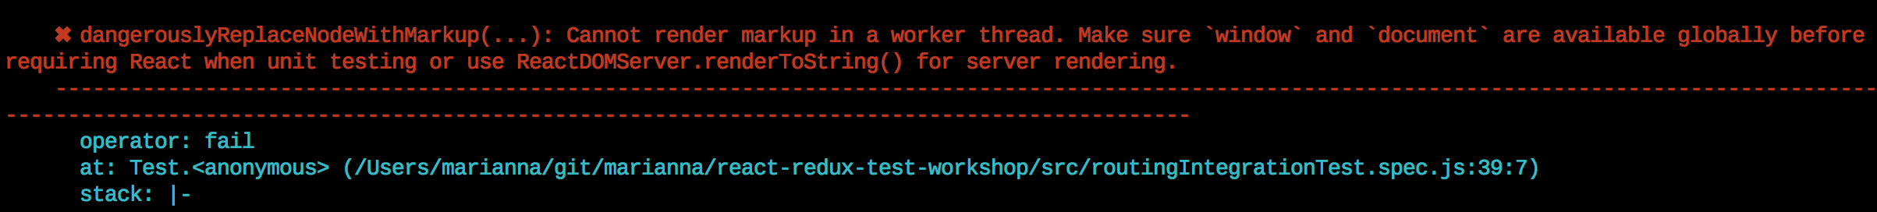
RUN INTEGRATION TEST
At load time React determines if it can use DOM
In our case React is loaded before JSDOM
And our render function returns different type of root element (due to routing)
Therefore we get 'dangerouslyReplaceNodeWithMarkup... ' error
var canUseDOM=!!(
typeof window!=='undefined' &&
window.document &&
window.document.createElement
);
ExecutionEnvironment.canUseDOM=canUseDOM;
If React is loaded before those conditions will be true, it assumes it can't use DOM
Notes:
At load time React determines if it can use DOM, and stores it as a boolean If react is included before JSDOM, we got 'dangerouslyReplaceNodeWithMarkup...' when Component render function returns different type of root elemet
Solutions: 1. use manual patch : require('fbjs/lib/ExecutionEnvironment').canUseDOM = true 2. Or ensure that you don't load React before you set up JSDOM, which is the only way I'm positive about but it's also the most difficult and bug prone. require('fbjs/lib/ExecutionEnvironment').canUseDOM = true
import test from 'tape' import {createDom} from '../../test/utils/index' import React from 'react' import {Provider} from 'react-redux' import {mount} from 'enzyme' import GifSearchEngineContainer from '../../src/gif-search-app/containers/GifsSearchEngineContainer' import configureStore from '../../src/gif-search-app/store/configureStore' import {createInitialAppState} from '../../src/gif-search-app/store/rootReducer' import Favorites from '../../src/gif-search-app/containers/FavoritesContainer' import {Router, Route, createMemoryHistory} from 'react-router' import {syncHistoryWithStore} from 'react-router-redux' test('Integration Test: Check Routing', t => { t.plan(4) try { createDom() const store = configureStore(createInitialAppState()) const browserHistory = createMemoryHistory('/') const history = syncHistoryWithStore(browserHistory, store) const wrapper = mount( <Provider store={store}> <Router history={history}> <Route path="/" component={GifSearchEngineContainer}/> <Route path="favorites" component={Favorites}/> </Router> </Provider>) let gifEngineView = wrapper.find(GifSearchEngineContainer) let favoritesView = wrapper.find(Favorites) t.equal(gifEngineView.length, 1, 'should render GifSearchEngine View') t.equal(favoritesView.length, 0, 'should NOT render Favorites View') const element = wrapper.find('a') element.simulate('click', {button: 0}) gifEngineView = wrapper.find(GifSearchEngineContainer) favoritesView = wrapper.find(Favorites) t.equal(gifEngineView.length, 0, 'should NOT render GifSearchEngine View after click on \'Show Favorite\'') t.equal(favoritesView.length, 1, 'should render Favorites View after click on \'Show Favorite\'') } catch (e) { console.log(e.stack) t.fail(e.message) t.end() } })

Slide 73
SOLUTIONS:
Use manual monkey patch:
Ensure that React is not loaded before you setup JSDOM
Use jsdom-global
Update test run command with -r jsdom-global/register
require('fbjs/lib/ExecutionEnvironment').canUseDOM = true
"test": "tape -r babel-register -r babel-polyfill -r jsdom-global/register \"{test/integration,src}/**/*.spec.js\" --tap | tap-spec"
Notes:
At load time React determines if it can use DOM, and stores it as a boolean If react is included before JSDOM, we got 'dangerouslyReplaceNodeWithMarkup...' when Component render function returns different type of root elemet
Solutions: 1. use manual patch : require('fbjs/lib/ExecutionEnvironment').canUseDOM = true 2. Or ensure that you don't load React before you set up JSDOM, which is the only way I'm positive about but it's also the most difficult and bug prone. require('fbjs/lib/ExecutionEnvironment').canUseDOM = true
import test from 'tape' import {createDom} from '../../test/utils/index' import React from 'react' import {Provider} from 'react-redux' import {mount} from 'enzyme' import GifSearchEngineContainer from '../../src/gif-search-app/containers/GifsSearchEngineContainer' import configureStore from '../../src/gif-search-app/store/configureStore' import {createInitialAppState} from '../../src/gif-search-app/store/rootReducer' import Favorites from '../../src/gif-search-app/containers/FavoritesContainer' import {Router, Route, createMemoryHistory} from 'react-router' import {syncHistoryWithStore} from 'react-router-redux' test('Integration Test: Check Routing', t => { t.plan(4) try { createDom() const store = configureStore(createInitialAppState()) const browserHistory = createMemoryHistory('/') const history = syncHistoryWithStore(browserHistory, store) const wrapper = mount( <Provider store={store}> <Router history={history}> <Route path="/" component={GifSearchEngineContainer}/> <Route path="favorites" component={Favorites}/> </Router> </Provider>) let gifEngineView = wrapper.find(GifSearchEngineContainer) let favoritesView = wrapper.find(Favorites) t.equal(gifEngineView.length, 1, 'should render GifSearchEngine View') t.equal(favoritesView.length, 0, 'should NOT render Favorites View') const element = wrapper.find('a') element.simulate('click', {button: 0}) gifEngineView = wrapper.find(GifSearchEngineContainer) favoritesView = wrapper.find(Favorites) t.equal(gifEngineView.length, 0, 'should NOT render GifSearchEngine View after click on \'Show Favorite\'') t.equal(favoritesView.length, 1, 'should render Favorites View after click on \'Show Favorite\'') } catch (e) { console.log(e.stack) t.fail(e.message) t.end() } })

Slide 74
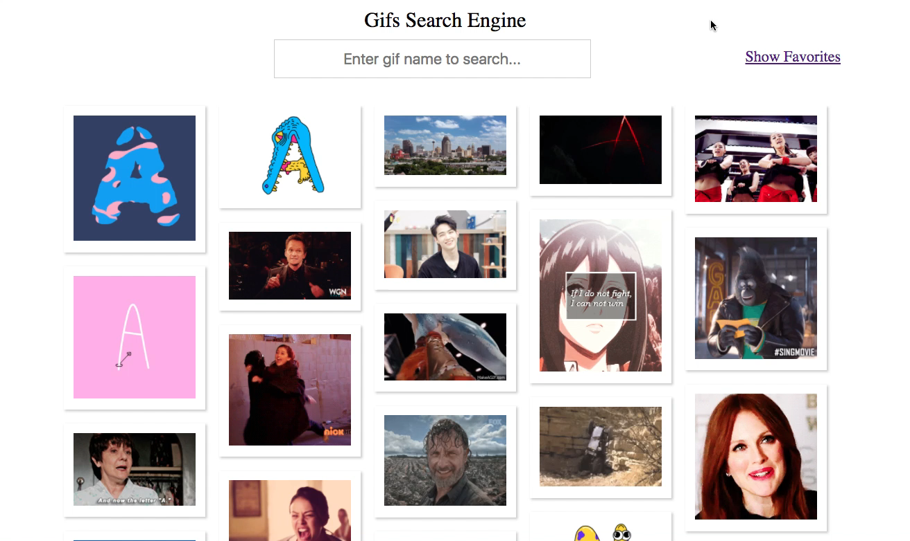
FULL INTEGRATION

Slide 75
FULL INTEGRATION TEST PLAN
Render the Gif Engine App into the DOM
Click on the ‘Show Favorites’ link
Check that favorites list view is empty
Click on the ‘Go Back’ link
Select the gif
Check that a Modal Dialog is rendered
Mark the gif inside Modal Dialog as Favorite
Close Modal Dialog
Check that Modal is not rendered
Route to Show Favorites
Check that there is a favorite gif in the list
Notes:
'use strict' import React from 'react' import test from 'tape' import {Provider} from 'react-redux' import {createDom} from '../test/utils' import ReactDOM from 'react-dom' import {gifsList} from '../test/mocks/dataMocks' import configureStore from '../src/gif-search-app/store/configureStore' import {syncHistoryWithStore} from 'react-router-redux' import {createInitialAppState} from '../src/gif-search-app/store/rootReducer' import GifSearchEngineContainer from '../src/gif-search-app/containers/GifsSearchEngineContainer' import Favorites from '../src/gif-search-app/containers/FavoritesContainer' import {Router, Route, createMemoryHistory} from 'react-router' test.only('Full Integration Test: ', t => { t.plan(12) let contentDiv = null try { createDom() const docQuerySelector = document.querySelector.bind(document) const docQuerySelectorAll = document.querySelectorAll.bind(document) const REACT_MODAL_PORTAL = 'ReactModalPortal' const store = configureStore(createInitialAppState(gifsList)) const browserHistory = createMemoryHistory('/') const history = syncHistoryWithStore(browserHistory, store) const bodyElement = docQuerySelector('body') contentDiv = window.document.createElement('div') bodyElement.appendChild(contentDiv) ReactDOM.render( <Provider store={store}> <Router history={history}> <Route path="/" component={GifSearchEngineContainer}/> <Route path="favorites" component={Favorites}/> </Router> </Provider>, contentDiv) t.equal(docQuerySelector('.gif-list').children.length, 3, '3 gifs are displayed ') t.pass('• go to show favorites') let favoritesLinkElement = docQuerySelector('.showFavorites') favoritesLinkElement.click() t.equal(docQuerySelector('.gif-list').children.length, 0, 'favorite list is empty') t.pass('• click on Back Link') docQuerySelector('.back').click() t.pass('• click on first gif to open modal dialog') const selectedGif = docQuerySelectorAll('.gif-item')[0] selectedGif.click() let modalPortal = docQuerySelector(`.${REACT_MODAL_PORTAL}`) t.equal(modalPortal.children.length, 1, 'should render modal dialog with content ') t.pass('• set selected gif in modal as favorite') docQuerySelector('.star').click() t.equal(docQuerySelector('.star-favorite').className, 'star-favorite', 'should render favorite start ') t.pass('• close Modal Dialog') const closeButton = docQuerySelector('button') closeButton.click() modalPortal = docQuerySelector(`.${REACT_MODAL_PORTAL}`) t.equal(modalPortal, null, 'modal dialog should not be rendered after close') t.pass('• go to show favorites') favoritesLinkElement = docQuerySelector('.showFavorites') favoritesLinkElement.click() t.equal(docQuerySelector('.gif-list').children.length, 1, 'favorite list has a one gif ') } catch (e) { console.log(e.stack) t.fail(e.message) t.end() } finally { ReactDOM.unmountComponentAtNode(contentDiv) } })

Slide 76
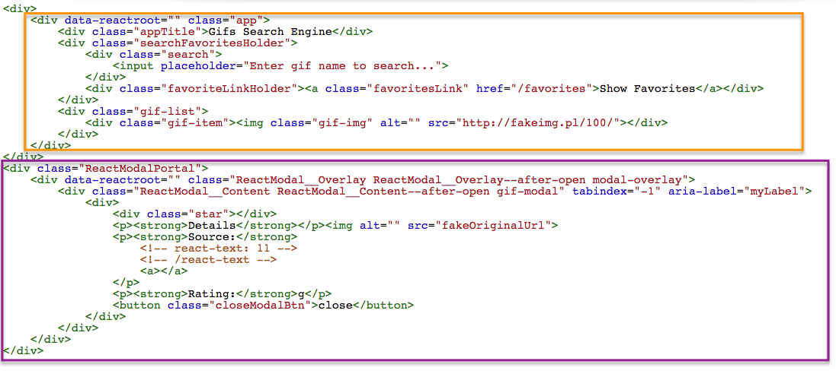
APP DOM STRUCTURE WITH OPENED MODAL

Slide 77
FULL INTEGRATION TEST PLAN
Render the Gif Engine App into the DOM
Click on the ‘Show Favorites’ link
Check that favorites list view is empty
Click on the ‘Go Back’ link
Select the gif
Check that a Modal Dialog is rendered
Mark the gif inside Modal Dialog as Favorite
Close Modal Dialog
Check that Modal is not rendered
Route to Show Favorites
Check that there is a favorite gif in the list
Use ReactDOM.render to render App into JSDOM
Use document.querySelector() API to traverse DOM
Notes:
'use strict' import React from 'react' import test from 'tape' import {Provider} from 'react-redux' import {createDom} from '../test/utils' import ReactDOM from 'react-dom' import {gifsList} from '../test/mocks/dataMocks' import configureStore from '../src/gif-search-app/store/configureStore' import {syncHistoryWithStore} from 'react-router-redux' import {createInitialAppState} from '../src/gif-search-app/store/rootReducer' import GifSearchEngineContainer from '../src/gif-search-app/containers/GifsSearchEngineContainer' import Favorites from '../src/gif-search-app/containers/FavoritesContainer' import {Router, Route, createMemoryHistory} from 'react-router' test.only('Full Integration Test: ', t => { t.plan(12) let contentDiv = null try { createDom() const docQuerySelector = document.querySelector.bind(document) const docQuerySelectorAll = document.querySelectorAll.bind(document) const REACT_MODAL_PORTAL = 'ReactModalPortal' const store = configureStore(createInitialAppState(gifsList)) const browserHistory = createMemoryHistory('/') const history = syncHistoryWithStore(browserHistory, store) const bodyElement = docQuerySelector('body') contentDiv = window.document.createElement('div') bodyElement.appendChild(contentDiv) ReactDOM.render( <Provider store={store}> <Router history={history}> <Route path="/" component={GifSearchEngineContainer}/> <Route path="favorites" component={Favorites}/> </Router> </Provider>, contentDiv) t.equal(docQuerySelector('.gif-list').children.length, 3, '3 gifs are displayed ') t.pass('• go to show favorites') let favoritesLinkElement = docQuerySelector('.showFavorites') favoritesLinkElement.click() t.equal(docQuerySelector('.gif-list').children.length, 0, 'favorite list is empty') t.pass('• click on Back Link') docQuerySelector('.back').click() t.pass('• click on first gif to open modal dialog') const selectedGif = docQuerySelectorAll('.gif-item')[0] selectedGif.click() let modalPortal = docQuerySelector(`.${REACT_MODAL_PORTAL}`) t.equal(modalPortal.children.length, 1, 'should render modal dialog with content ') t.pass('• set selected gif in modal as favorite') docQuerySelector('.star').click() t.equal(docQuerySelector('.star-favorite').className, 'star-favorite', 'should render favorite start ') t.pass('• close Modal Dialog') const closeButton = docQuerySelector('button') closeButton.click() modalPortal = docQuerySelector(`.${REACT_MODAL_PORTAL}`) t.equal(modalPortal, null, 'modal dialog should not be rendered after close') t.pass('• go to show favorites') favoritesLinkElement = docQuerySelector('.showFavorites') favoritesLinkElement.click() t.equal(docQuerySelector('.gif-list').children.length, 1, 'favorite list has a one gif ') } catch (e) { console.log(e.stack) t.fail(e.message) t.end() } finally { ReactDOM.unmountComponentAtNode(contentDiv) } })

Slide 78
AGENDA
Intro
Why ?
What ?
Testing Guidelines
How
Test Environment
Hands-On
React Component
Redux: Action, Reducer, Container (git checkout redux_testing)
Integration Test (git checkout integration_tests)

Slide 79
LIVE LONG AND PROSPER WITH TESTING
…and may the Fourth be with us…

